Slide 1


Green Pace
Security Policy Presentation
Developer: Aamir Rahman

Slide 2

OVERVIEW: DEFENSE IN DEPTH
Develop and maintain secure software
Practice Defense-in-Depth during development
Defense-in-Depth aids in protecting software with multiple security layers
Helps find and fix vulnerabilities
Stop attacks quickly

Slide 3
THREATS MATRIX
Likely Threat has a high chance of occurring more frequently | Priority Standard should be implemented quickly and top of the list of priority
Low priority Standard should get implemented eventually. The risks need to be on the list but are NOT detrimental | Unlikely Threat has a low chance of occurring; won’t happen often but can occur

Slide 4
10 PRINCIPLES
Validate Input Data
Heed Compiler Warnings
Architect and Design for Security Policies
Keep It Simple
Default Deny
Adhere to the Principle of Least Privilege
Sanitize Data Sent to Other Systems
Practice Defense-in-Depth
Use Effective Quality Assurance Techniques
Adopt a Secure Coding Standard

Slide 5
CODING STANDARDS
Coding Standards | Severity | Likelihood | Remediation Cost | Priority | Level
STD-001-CPP | Medium | Unlikely | Medium | P4 | L3
STD-002-CPP | High | Likely | Medium | P18 | L1
STD-003-CPP | High | Likely | Medium | P18 | L1
STD-004-CPP | Low | Likely | Low | P9 | L2
STD-005-CPP | High | Likely | Medium | P18 | L1
STD-006-C | Low | Unlikely | High | P1 | L3
STD-007-CPP | Low | Likely | Low | P9 | L2
STD-008-CPP | Low | Probable | High | P2 | L3
STD-009-C | High | Probable | Medium | P12 | L1
STD-010-C | Medium | Probable | High | P4 | L3
STD-002-CPP
STD-003-CPP
STD-005-CPP
STD-009-C
STD-001-CPP
STD-010-C
STD-004-CPP
STD-006-C
STD-007-CPP
STD-008-CPP

Slide 6
ENCRYPTION POLICIES
Encryption in Rest
Stored data
Encryption at Flight
Data being transferred from one place to another
Encryption in Use
Data at any lifecycle stage(rest, flight, or in use)

Slide 7
TRIPLE-A POLICIES
Authentication
Logins
Single-Use Keys
Biometrics
Authorization
Permissions
Admin, Tech Support, Associate, Verified User, etc.
Accounting
Activity logs

Slide 8
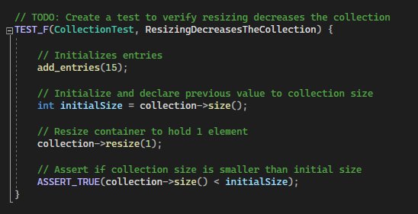
Unit Testing
Test to verify resizing decreases the collection

Slide 9
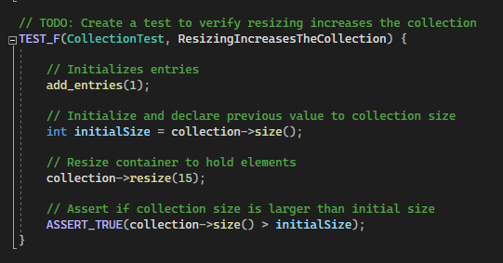
Unit Testing
Test to verify resizing increases the collection

Slide 10
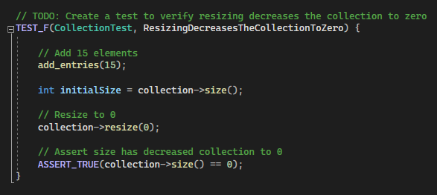
Unit Testing
Test to verify resizing decreases the collection to zero

Slide 11
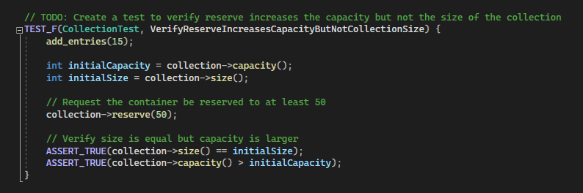
Unit Testing
Test to verify reserve increases the capacity but not the size of the collection.

Slide 12
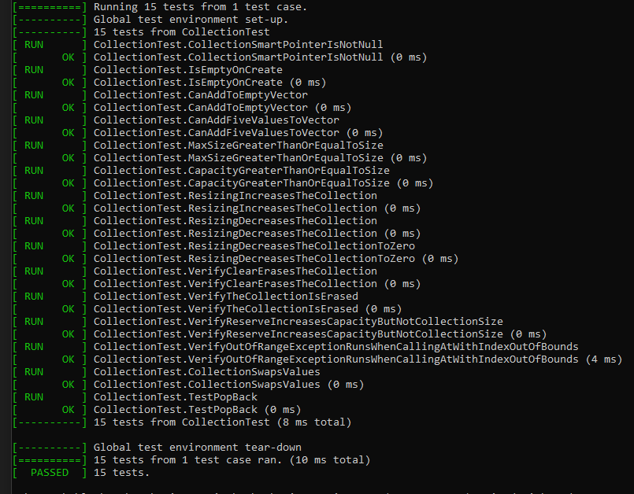
Unit Testing
Complete testing passed

Slide 13

AUTOMATION SUMMARY

Slide 14
TOOLS
Security-Focused Software Development Life Cycle
Plan/Design
Planning Tools
Build
Compiler
Unit Testing
Coding Standards
Testing
Unit Testing
Static Code Analyzer
Dynamic Application Security Tests
Deployment
Configuration Management
Runtime Verification Tools

Slide 15
RISKS AND BENEFITS
Act Now
Mitigates any current threat risks
May save money in the long run by preventing any imminent attacks
Secure people’s information quickly / Keep the trust of our clients
May not have all the resources to act now
High upfront cost
Act Later
Time to retrieve resources and money
Attacks may happen in the meantime
Lose trust of clients if a data breach occurs
Could cause a bigger, more expensive, issue in the long run

Slide 16
RECOMMENDATIONS
Follow security standards
Encryption Policies
Revise and Edit Policy Regularly
Reference All CERT Coding Standards
Start Implementing Encryption and Triple-A policies as soon as possible
Teamwork
Security Training
Start Internal Defense-in-Depth Layers

Slide 17
CONCLUSIONS
Great Starting Point To Prevent Future Attacks
Always Reference CERT Coding Standards
Follow The 10 Core Security Principles Throughout Lifecycle
Implement Encryption and Triple-A Policies As Much As Possible
Acting Right Away and Don’t Delay

Slide 18
REFERENCES
Carnegie Mellon University Software Engineering Institute. SEI External Wiki Home - Homepage - Confluence (cmu.edu). Provides information about security policies for programming systems and languages.
Das, P. (n.d.). In-Use Encryption – What it is and How Companies Benefit. Soterosoft. Retrieved from Data in Use Encryption | What It Is and How Companies Benefit (soterosoft.com)
Model, I. (2017, May 17). What is encryption at rest, and why is it important for your business? Brightline Technologies. Retrieved June 8, 2022, from https://brightlineit.com/encryption-at-rest-important-business/
Shacklett, M. E. (2021, September 27). What is authentication? SearchSecurity. Retrieved June 12, 2022, from https://www.techtarget.com/searchsecurity/definition/authentication#:~:text=Authentication%20enables%20organizations%20to%20keep,network%2Dbased%20applications%20or%20services

